Slide 1
Xamarin.Android
Raghavender

Slide 2
Agenda
Review common navigation patterns
Understand platform support

Slide 3
Stack navigation
System-provided software back button (physical hardware button on older devices)

Slide 4
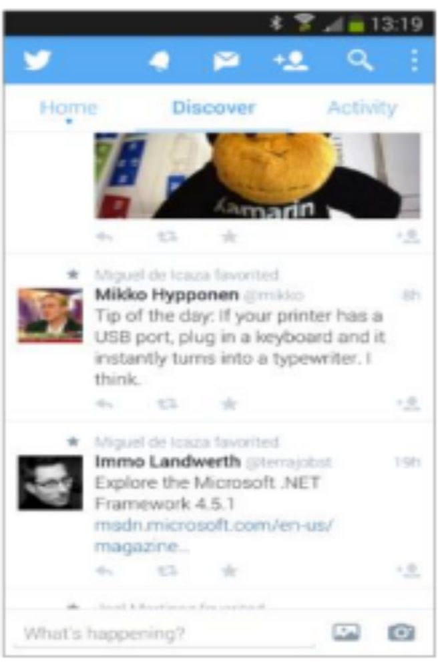
Tab navigation_x0002_
Allows for quick task switching
Current tab selected for context

Slide 5
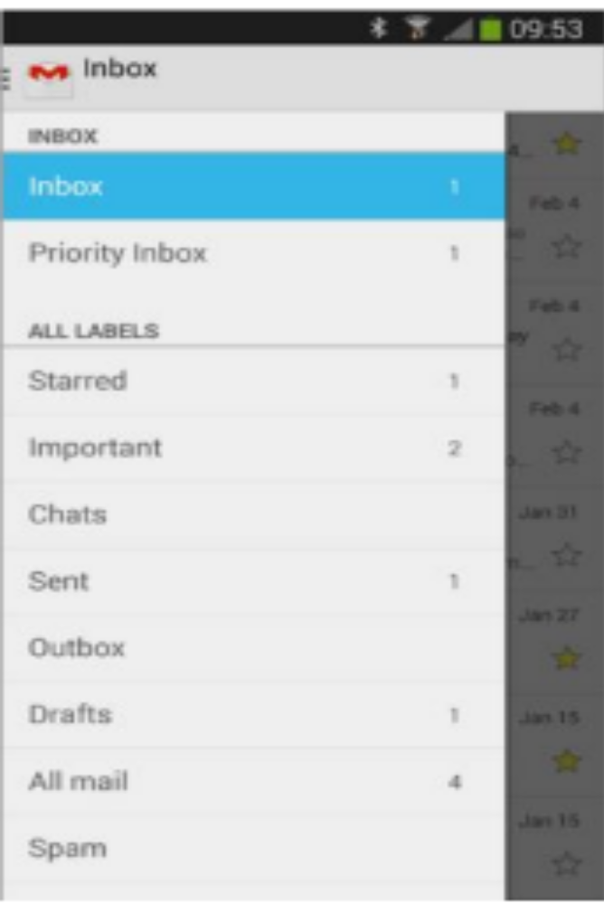
Flyout navigation_x0002_
Allows for quick task switching (and with more options)
Minimal screen space needed when closed

Slide 6
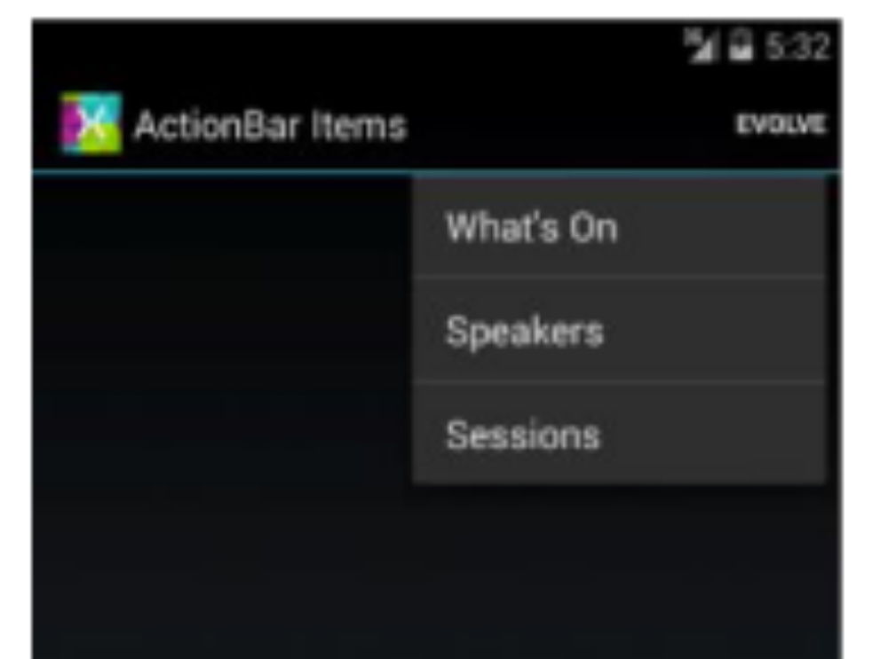
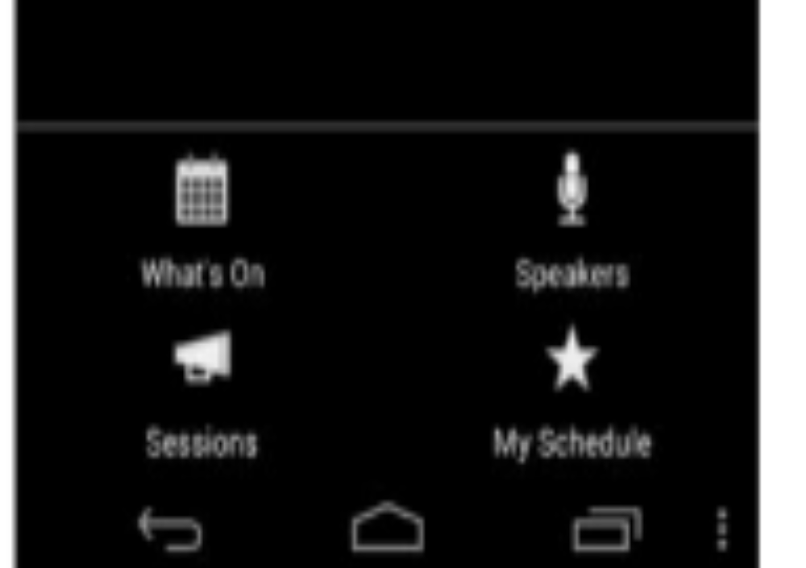
Other navigation patterns
ActionBar Items(buttons in title bar)
Options menu (triggered by in-app button or dedicated menu button)

Slide 7
Q & A

Slide 8
thank you!

